Slide 1

7.4 Clocked Synchronous Sequential Logic Design Example

Slide 2

7.4 Clocked Synchronous Sequential Logic Design Example
Clocked synchronous circuit is very important, which is applied to every walk of life. In this section, we give some examples for mastering the design method.

Slide 3
Example 1(1)
Choose T flip-flop,design a 2-bit binary system counter which is decreased 1 by clock pulse. The circuit has one input signal X. If X=0,circuit state hold on the previous state. If X=1, when clock pulse reach, the counter if decrease 1. The counter has one output Z, when producing carry bit, Z=1, the others Z=0.

Slide 4
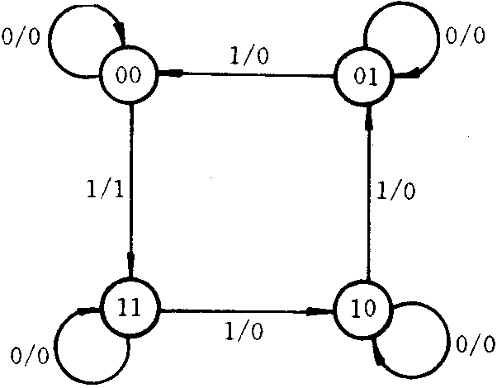
Example 1(2)
The problem is clearly defined with state numbers and the relation of state changer, design step as follows:
Step 1. make state diagrams and state table. According to the requirement,we use state variables y2 and y1.
输入 状态y2y1 |  | X=0 |  |  | X=1
 |  | y2* | y1* | /Z | y2* | y1* | /Z
0 | 0 | 0 | 0 | 0 | 1 | 1 | 1
0 | 1 | 0 | 1 | 0 | 0 | 0 | 0
1 | 1 | 1 | 1 | 0 | 1 | 0 | 0
1 | 0 | 1 | 0 | 0 | 0 | 1 | 0

Slide 5
Example 1(3)
输入 状态y2y1 |  | X=0 |  |  |  |  | X=1
 |  | y2* | y1* | /Z | T2 | T1 | y2* | y1* | /Z | T2 | T1
0 | 0 | 0 | 0 | 0 | 0 | 0 | 1 | 1 | 1 | 1 | 1
0 | 1 | 0 | 1 | 0 | 0 | 0 | 0 | 0 | 0 | 0 | 1
1 | 1 | 1 | 1 | 0 | 0 | 0 | 1 | 0 | 0 | 0 | 1
1 | 0 | 1 | 0 | 0 | 0 | 0 | 0 | 1 | 0 | 1 | 1
输入
状态y2y1
X
输入
状态y2y1
X
0
1
0
1
0
0
0
1
0
0
0
1
0
1
0
0
0
1
0
1
1
1
0
0
1
1
0
1
1
0
0
1
1
0
0
1
T2=xy1’
T1=x
输入
状态y2y1
X
step 2:Derive excitation function and output function.
According to the excitation of state table and T flip-flop,we can derive truth table and Karnaugh map.Through simplification, we derive excitation function and output function as follows:
T2=xyl’ T1=x Z=xy2’y1’
0
1
0
0
0
1
0
1
0
0
1
1
0
0
1
0
0
0
Z=xy2’y1’

Slide 6
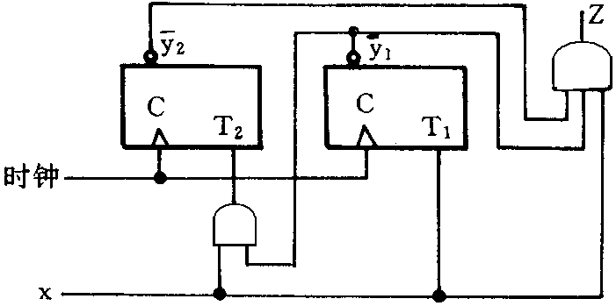
Example 1(4)
Step 3:Draw logic circuit diagram.

Slide 7
Example 2(1)
Design a 2-bit bi-directional shift register, serial input and parallel output,which has 2 inputs x1 and x2. x2 is a control-port, which control shift direction. X1 is a data-port. If X2=0, X1 send serial data to register's high-bit, and it shift from high bit to low bit. If X2=1, X1 send serial data to register's low-bit, and it shift from low bit to high bit. The output of register is trigger's state.

Slide 8
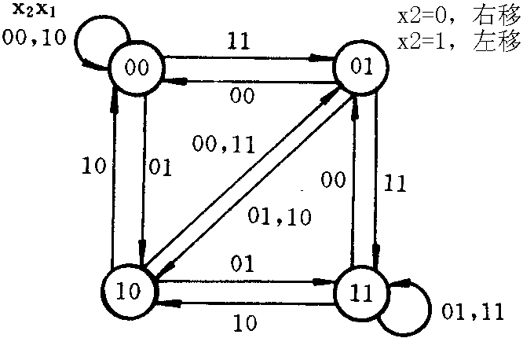
Example 2(2)
Step 1. make state diagrams and state table. . According to the requirement,we use state variables y2 and y1, y2 is high bit, y1 is low bit.
输入 状态 x2x1 y2y1 |  | x2x1=00 |  | x2x1=01 |  | x2x1=11 |  | x2x1=10
 |  | Y2 | Y1 | Y2 | Y1 | Y2 | Y1 | Y2 | Y1
0 | 0 | 0 | 0 | 1 | 0 | 0 | 1 | 0 | 0
0 | 1 | 0 | 0 | 1 | 0 | 1 | 1 | 1 | 0
1 | 1 | 0 | 1 | 1 | 1 | 1 | 1 | 1 | 0
1 | 0 | 0 | 1 | 1 | 1 | 0 | 1 | 0 | 0

Slide 9
Example 2(3)
Step 2: Draw Karnaugh map, derive excitation function.
If we choose D flip-flop,According to the excitation of state table and D flip-flop,we can derive excitation function Karnaugh map as follows:
输入
状态x2x1
y2y1
00
01
11
10
输入
状态x2x1
y2y1
00
01
11
10
0
0
0
1
0
0
0
0
0
0
1
0
0
1
0
1
1
1
0
1
0
0
1
0
1
1
0
1
1
1
1
1
1
1
1
0
1
0
0
1
0
0
1
0
1
1
1
0
Y2=D2=x2’x1+x2y1
Y1=D1=x2x1+x2’y2

Slide 10
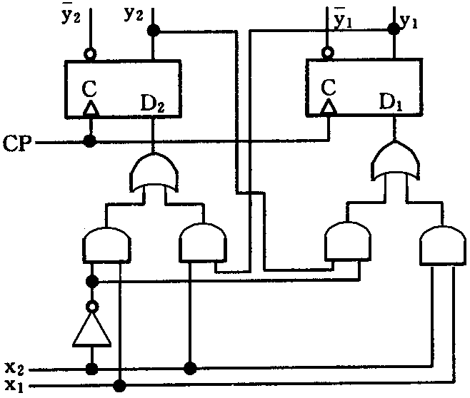
Example 2(4)
Step 3:Draw logic circuit diagram.
D2=x2’x1+x2y1
D1=x2x1+x2’y2

Slide 11
Example 3(1)
Choose J-K flip-flop, design a '101' sequence detector. The circuit has one input X and one output Z.When checking '101' sequence in random-input signal, Z=1. The typical input and output sequence as follows:
Input X： 0 0 1 0 1 0 1 1 0 1 0 0
Output Z：0 0 0 0 1 0 1 0 0 1 0 0

Slide 12
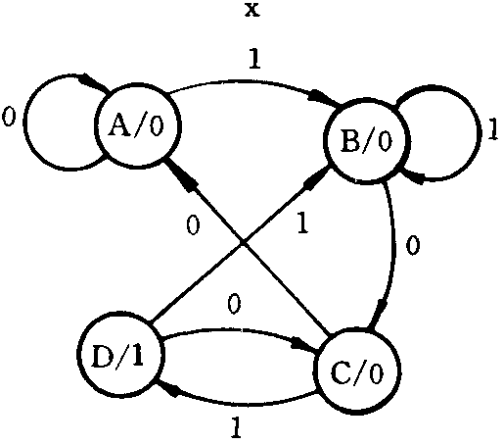
Example 3(2)
If we use Moore type clocked synchronous sequential logic circuit,design progress is as follows:
Step 1: make state diagrams and state table. According to the requirement, If we set initial state as A, we can derive state diagrams and state table as follows:
输入x 状态 | x=0 | x=1 | 输出
A | A | B | 0
B | C | B | 0
C | A | D | 0
D | C | B | 1

Slide 13
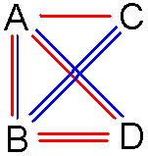
Example 3(3)
Step 2:State Minimization.According to the minimization rules,the previous state table contains the fewest possible states.
Step 3:State Assignment.There are 4 states in the state table,so we need to use 2 bits,in the sense that the circuit has 2 flip-flops.If we use state variables y2 and y1, we can derive code state and state table as follows:
输入x 状态 y2y1 |  | x=0 |  | x=1 |  | 输出
 |  | Y2 | Y1 | Y2 | Y1 | Z
0 | 0 | 0 | 0 | 0 | 1 | 0
0 | 1 | 1 | 0 | 0 | 1 | 0
1 | 1 | 1 | 0 | 0 | 1 | 1
1 | 0 | 0 | 0 | 1 | 1 | 0
y2 y1 | 0 | 1
0 | A | C
1 | B | D

Slide 14
Example 3(4)
step 4: Derive excitation function and output function.According to the excitation of state table and J-K flip-flop,we can derive truth table as follows:
输入 x 状态y2y1 |  |  |  | x=0 |  |  |  |  |  | x=1 |  |  |  | 输出
 |  | Y2 | Y1 | J2 | K2 | J1 | K1 | Y2 | Y1 | J2 | K2 | J1 | K1 | Z
0 | 0 | 0 | 0 | 0 | d | 0 | d | 0 | 1 | 0 | d | 1 | d | 0
0 | 1 | 1 | 0 | 1 | d | d | 1 | 0 | 1 | 0 | d | d | 0 | 0
1 | 1 | 1 | 0 | d | 0 | d | 1 | 0 | 1 | d | 1 | d | 0 | 1
1 | 0 | 0 | 0 | d | 1 | 0 | d | 1 | 1 | d | 0 | 1 | d | 0

Slide 15
Example 3(5)
输入 x 状态y2y1 |  | x=0 |  |  |  | x=1 |  |  |  | 输出
 |  | J2 | K2 | J1 | K1 | J2 | K2 | J1 | K1 | Z
0 | 0 | 0 | d | 0 | d | 0 | d | 1 | d | 0
0 | 1 | 1 | d | d | 1 | 0 | d | d | 0 | 0
1 | 1 | d | 0 | d | 1 | d | 1 | d | 0 | 1
1 | 0 | d | 1 | 0 | d | d | 0 | 1 | d | 0
输入
状态y2y1
X
0
1
0
0
0
0
0
1
1
0
1
1
d
d
1
0
d
d
J2=x’y1
输入
状态y2y1
X
输入
状态y2y1
X
输入
状态y2y1
X
输入
状态y2y1
X
0
1
0
1
0
1
0
1
0
0
d
d
0
0
0
1
0
0
d
d
0
0
0
0
0
1
d
d
0
1
d
d
0
1
1
0
0
1
0
0
1
1
0
1
1
1
d
d
1
1
1
0
1
1
1
1
1
0
1
0
1
0
0
1
1
0
d
d
1
0
0
0
K2=x’y1’+xy1
J1=x
K1=x’
Z=y2y1

Slide 16
Example 3(6)
Derive excitation function and output function as follows:
J2=x’y1
K2=x’y1’+xy1=x’⊕y1
J1=x
K1=x’
Z=y2yl

Slide 17
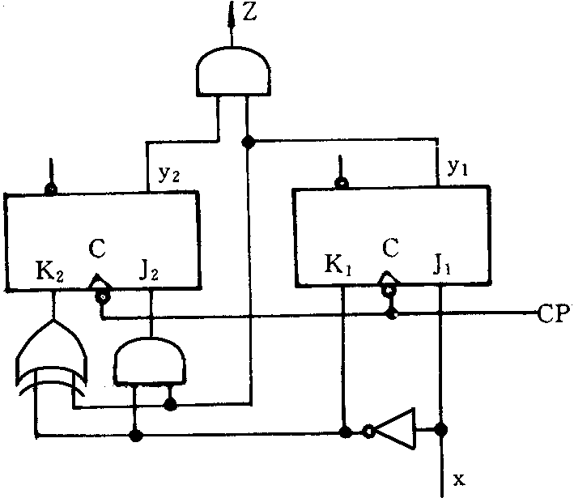
Example 3(7)
Step 5: Draw logic circuit diagram.

Slide 18
Example 4(1)
Design a 3-bit binary code serial parity detector. From input-port X, input serial binary code, each 3 bits as a group, when the numbers 1 in the group is even numbers, the output Z=1, the others Z=0.

Slide 19
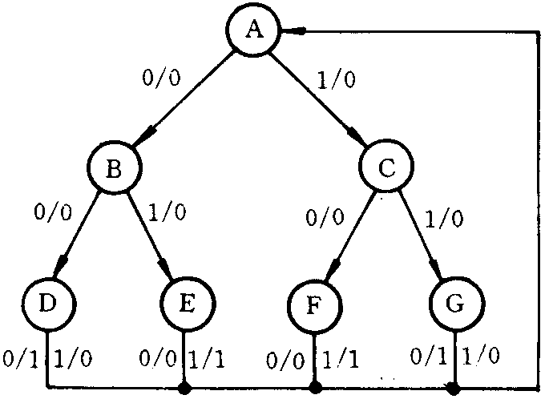
Example 4(2)
The characteristic of code detector is the input signal grouping by bits, every group has the same check progress. After checked one group, the circuit return to initial state, and check next group.
Step 1: make initial state diagrams and state initial table.
输入 状态 | X=0 | X=1
A | B/0 | C/0
B | D/0 | E/0
C | F/0 | G/0
D | A/1 | A/0
E | A/0 | A/1
F | A/0 | A/1
G | A/1 | A/0

Slide 20
Example 4(3)
Step 2: State Minimization.
输入 状态 | X=0 | X=1
A | B/0 | C/0
B | D/0 | E/0
C | E/0 | D/0
D | A/1 | A/0
E | A/0 | A/1

Slide 21
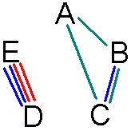
Example 4(4)
Step 3: Coded states.There are 5 states in the fewest state table,so we needed to use 3-bit binary code to describe states,the circuit has 3 flip-flops. If we use variables y3,y2 and y1,according to the coded state's 3-rule,we can design coded states as follows:
 |  |  | X=0 |  |  |  | X=1
0 | 0 | 0 | 0 | 1 | 0 | /0 | 1 | 1 | 0 | /0
0 | 0 | 1 | d | d | d | /d | d | d | d | /d
0 | 1 | 0 | 1 | 0 | 0 | /0 | 1 | 0 | 1 | /0
0 | 1 | 1 | d | d | d | /d | d | d | d | /d
1 | 0 | 0 | 0 | 0 | 0 | /1 | 0 | 0 | 0 | /0
1 | 0 | 1 | 0 | 0 | 0 | /0 | 0 | 0 | 0 | /1
1 | 1 | 0 | 1 | 0 | 1 | /0 | 1 | 0 | 0 | /0
1 | 1 | 1 | d | d | d | /d | d | d | d | /d
y3y2 y1 | 00 | 01 | 11 | 10
0 | A | B | C | D
1 |  |  |  | E

Slide 22
Example 4(5)
Step 4: Derive excitation function and output function.
If we choose D flip-flop, According to the excitation of state table and D flip-flop, we can derive excitation function Karnaugh map as follows:

Slide 23
Example 4(6)
D3 D2 D1 Z
xy3
y2y1
00
01
11
10
xy3
y2y1
00
01
11
10
xy3
y2y1
00
01
11
10
xy3
y2y1
00
01
11
10
00
0
0
0
1
00
1
0
0
1
00
0
1
0
0
00
0
0
0
0
01
d
0
0
d
01
d
0
0
d
01
d
0
0
d
01
d
0
1
d
11
d
d
d
d
11
d
d
d
d
11
d
d
d
d
11
d
d
d
d
10
1
1
1
1
10
0
0
0
0
10
0
1
0
1
10
0
0
0
0
D3=xy3’+y2 D2=y3’y2’=(y3+y2)’
D1=x’y3y2+xy3’y2=(x⊕y3)y2 Z=xyl+x’y3y2’y1’

Slide 24
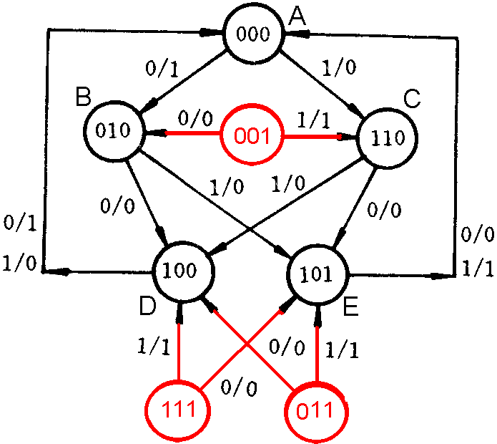
Example 4(7)

Slide 25
Example 4(8)
讨论: 通常，当所设计的电路中触发器所能表示的状态数大于有效状态数时，需要对所设计的电路进行实际工作状态讨论。主要讨论两个问题。
第一，电路万一偶然进入无效状态，能否在输入信号和时钟脉冲作用下自动进入有效状态，如果能自动进入有效状态，则称为具有自恢复功能；否则，称为“挂起”。
第二，电路万一处在无效状态，是否会产生错误输出信号。一旦发现存在“挂起”现象或错误输出现象，就必须对设计的方案进行修改，否则，将影响电路工作的可靠性，甚至破坏正常工作。
实际上只需要根据确定的激励函数和输出函数表达式作出相应状态表和状态图，便可使需讨论的两个问题一目了然。至于修改设计方案的问题，则只涉及到激励函数和输出函数化简时对无效状态下任意项的处理问题。

Slide 26
Example 4(9)
当电路中包含多个无效状态时，往往又将无效状态构成的集合称作状态的无效序列，相应地将正常工作下的状态集合称为状态的有效序列。本例的状态无效序列中包含001、011和111共3个无效状态，它们在化简激励函数和输出函数时被作为无关条件处理，即在这几个状态下，函数的值可根据化简的需要随意指定为1或者0。通常的做法是，在卡诺图上和1圈在一起即指定为1，否则为0。因此，只需检查化简时的卡诺图，便可知道无效状态下的激励函数和输出函数的取值，并推出相应次态，进而作出与设计方案对应的状态图或状态表，得出讨论结果。
本例中无效状态下的电路次态(激励函数同次态)和输出函数如右表。
 |  |  | X=0 |  |  |  | X=1
0 | 0 | 0 | 0 | 1 | 0 | /0 | 1 | 1 | 0 | /0
0 | 0 | 1 | 0 | 1 | 0 | /0 | 1 | 1 | 0 | /1
0 | 1 | 0 | 1 | 0 | 0 | /0 | 1 | 0 | 1 | /0
0 | 1 | 1 | 1 | 0 | 0 | /0 | 1 | 0 | 1 | /1
1 | 0 | 0 | 0 | 0 | 0 | /1 | 0 | 0 | 0 | /0
1 | 0 | 1 | 0 | 0 | 0 | /0 | 0 | 0 | 0 | /1
1 | 1 | 0 | 1 | 0 | 1 | /0 | 1 | 0 | 0 | /0
1 | 1 | 1 | 1 | 0 | 1 | /0 | 1 | 0 | 0 | /1

Slide 27
Example 4(10)
根据二进制状态表，可作出该设计方案的状态图如右图。由该状态图可知，此方案的无效状态序列不会产生“挂起”现象，但在无效状态下输入1时会产生错误的1输出。为此，应将输出函数表达式修改为：
Z=∑m(4,13)
=x’y3y2’y1’+xy3y2’y1
=y3y2’(x’yl’+xyl)
=y3y2’(x⊕yl)’
=(y3’+y2+(x⊕y1))’

Slide 28
Summary
1. Clocked Synchronous Sequential Logic’s basic concept
2. Analyze Clocked Synchronous Sequential Logic
3. Design Clocked Synchronous Sequential Logic

